Slide 1
MAVEN

Slide 2
MAVEN
Maven is a project management and comprehension tool that provides developers a complete build lifecycle framework. Development team can automate the project's build infrastructure in almost no time as Maven uses a standard directory layout and a default build lifecycle.
Maven provides developers ways to manage the following:
Builds
Documentation
Reporting
Dependencies
SCMs
Releases
Distribution
Mailing list
Maven project structure and contents are declared in an xml file, pom.xml, referred as Project Object Model (POM), which is the fundamental unit of the entire Maven system. It resides in the base directory of the project as pom.xml

Slide 3
Maven Installation
To install Maven on your own system (computer), go to the Maven download page and follow the instructions. Briefly speaking, what you need to do is:
Download and unzip Maven
Set the M2_HOME environment variable to point to the directory you unzipped Maven
Set the M2 environment variable to point to M2_HOME/bin (%M2_HOME%\bin on Windows, $M2_HOME/bin on unix)
Add M2 to the PATH environment variable (%M2% on Windows, $M2 on unix)
Open a command prompt and type 'mvn' (without quotes) and press enter
After typing in the 'mvn' command you should be able to see a Maven error written to the command prompt. Don't worry about the error. It is expected because you haven't yet any POM file to pass to Maven. But the fact that you get a Maven error means that Maven is now installed
Note: Maven uses Java when executing, so you need Java installed to. Maven needs a Java version 1.5 or later

Slide 4
Commands:-
$ java -version
export JAVA_HOME=/usr/local/java-current
export PATH=$PATH:$JAVA_HOME/bin/
$mvn --version
export M2_HOME=/usr/local/apache-maven/apache-maven3.3.1
export M2=$M2_HOME/bin
export MAVEN_OPTS=-Xms256m -Xmx512m

Slide 5
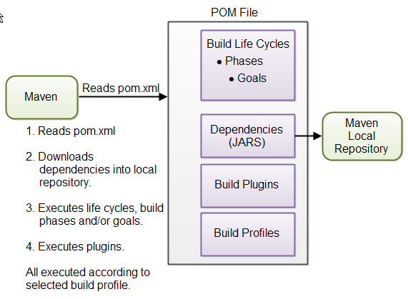
Maven Overview - Core Concepts

Slide 6
POM Example :-
<project xmlns="http://maven.apache.org/POM/4.0.0"
xmlns:xsi="http://www.w3.org/2001/XMLSchema-instance"
xsi:schemaLocation="http://maven.apache.org/POM/4.0.0
http://maven.apache.org/xsd/maven-4.0.0.xsd">
<modelVersion>4.0.0</modelVersion>
<groupId>com.companyname.project-group</groupId>
<artifactId>project</artifactId>
<version>1.0</version>
</project>
It should be noted that there should be a single POM file for each project.
SUPER POM:
The Super POM is Maven’s default POM. All POMs inherit from a parent or default (despite explicitly defined or not). This base POM is known as the Super POM, and contains values inherited by default.
Command :- mvn help:effective-pom

Slide 7
Maven Settings File
Maven has two settings files. In the settings files, you can configure settings for Maven across all Maven POM files. For instance, you can configure:
Location of local repository
Active build profile
The settings files are called settings.xml. The two settings files are located at:
The Maven installation directory: $M2_HOME/conf/settings.xml
The user's home directory: ${user.home}/.m2/settings.xml
Both files are optional. If both files are present, the values in the user home settings file overrides the values in the Maven installation settings file.
You can read more about the Maven settings files in the Maven Settings Reference

Slide 8
Project Dependencies
<dependencies>
<dependency>
<groupId>org.jsoup</groupId>
<artifactId>jsoup</artifactId>
<version>1.7.1</version>
</dependency>
<dependency>
<groupId>junit</groupId>
<artifactId>junit</artifactId>
<version>4.8.1</version>
<scope>test</scope>
</dependency>
</dependencies>

Slide 9
External Dependencies
<dependency>
<groupId>mydependency</groupId>
<artifactId>mydependency</artifactId>
<scope>system</scope>
<version>1.0</version>
<systemPath>${basedir}\war\WEB-INF\lib\mydependency.jar</systemPath>
</dependency>

Slide 10
Snapshot Dependencies
<dependency>
<groupId>com.jenkov</groupId>
<artifactId>java-web-crawler</artifactId>
<version>1.0-SNAPSHOT</version>
</dependency>

Slide 11
Maven Repositories
Maven has three types of repositories:
Local repository
Central repository
Remote repository
Maven searches these repositories for dependencies in the above sequence. First in the local repository, then in the central repository, and third in remote repositories if specified in the POM.

Slide 12
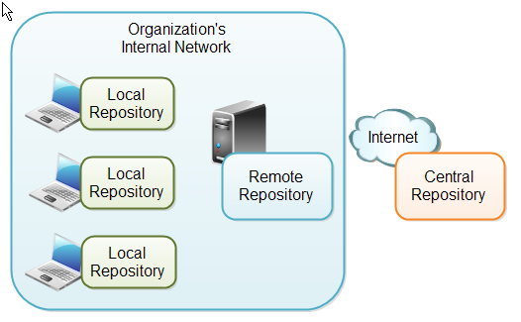
Maven repository types and location

Slide 13
Local Repository
Repository is a directory on the developer's computer. This repository will contain all the dependencies Maven downloads. The same Maven repository is typically used for several different projects. Thus Maven only needs to download the dependencies once, even if multiple projects depends on them (e.g. Junit).
By default, maven puts the local repository under user-home/.m2 directory. The path can be changed by explicitly providing the path in the settings.xml file as below:
<settings>
<localRepository>
d:\data\java\products\maven\repository
</localRepository>
</settings>

Slide 14
Central Repository
Repository provided by the Maven community
By default Maven looks in this central repository for any dependencies needed but not found in your local repository. Maven then downloads these dependencies into your local repository
You need no special configuration to access the central repository

Slide 15
Remote Repository
Repository on a web server from which Maven can download dependencies, just like the central repository
Can be located anywhere on the internet, or inside a local network
Often used for hosting projects internal to your organization, which are shared by multiple projects
For instance, a common security project might be used across multiple internal projects. This security project should not be accessible to the outside world, and should thus not be hosted in the public, central Maven repository. Instead it can be hosted in an internal remote repository.

Slide 16
Remote Repository ( Continued)
Dependencies found in a remote repository are also downloaded and put into your local repository by Maven
You can configure a remote repository in the POM file. Put the following XML elements right after the
<dependencies> element:
<repositories>
<repository>
<id>jenkov.code</id>
<url>http://maven.jenkov.com/maven2/lib</url>
</repository>
</repositories>

Slide 17
Project creation using maven archetype
Creating a project from an archetype involves three steps:
the selection of the archetype,
the configuration of that archetype,
the effective creation of the project from the collected information
Refer http://maven.apache.org/archetype/maven-archetype-plugin/usage.html for the usage details
From the command prompt, a new project can be created as in the example that follows:

Slide 18
Maven Archetype Example
We'll use maven-archetype-quickstart plugin to create a simple Java Project as below:
MVN>mvn archetype:generate
-DgroupId=com.companyname.bank
-DartifactId=consumerBanking
-DarchetypeArtifactId=maven-archetype-quickstart
-DinteractiveMode=false

Slide 19
Maven Plugins(in detail)
Maven is actually a plugin execution framework where every task is actually done by
plugins. Maven Plugins are generally used to :
create jar file
create war file
compile code files
unit testing of code
create project documentation
create project reports

Slide 20
Maven Plugins (Continued)
A plugin generally provides a set of goals and which can be executed using following syntax:
mvn [plugin-name]:[goal-name]
mvn compiler:compile

Slide 21
Maven Plugins (Continued)
Maven provided following two types of Plugins:
Build Plugins: They execute during the build and should be configured in the <build/> element of pom.xml
Reporting Plugins: They execute during the site generation and they should be configured in the <reporting/> element of the pom.xml

Slide 22
Maven Plugins (Continued)
Few Common Plugins :
clean : clean up target after the build and deletes the target directory
compiler : compiles Java source files
surefire: run the JUnit unit tests and creates test reports
jar : builds a JAR file from the current project
war : builds a WAR file from the current project
javadoc :generates Javadoc for the project
antrun : runs a set of ant tasks from any phase mentioned of the build

Slide 23
Maven Plugins(Continued)
<plugin>
<groupId>org.codehaus.modello</groupId>
<artifactId>modello-maven-plugin</artifactId>
<version>1.8.1</version>
<executions>
<execution>
<configuration>
<models>
<model>src/main/mdo/maven.mdo</model>
</models>
<version>4.0.0</version>
</configuration>
<goals>
<goal>java</goal>
</goals>
</execution>
</executions>
</plugin>

Slide 24
Maven Plugins (Continued)
Plugins are specified in pom.xml using plugins element
Each plugin can have multiple goals
You can define phase from where plugin should starts its processing using its phase element
You can configure tasks to be executed by binding them to goals of plugin
<executions> element helps to run the same goal multiple times with different configuration if needed
When multiple executions are given that match a particular phase, they are executed in the order specified in the POM, with inherited executions running first

